Slide 1
Modern Analytics Academy
Visualization
https://aka.ms/maa
Notes:
Good Day
Series
Today’s Topic
Intro

Slide 2





Modern Analytics Academy Team
Alex Karasek
Annie Xu
Brian Hitney
Chris Mitchell
Jason Virtue
Senior Cloud Solution Architect
Senior Cloud Solution Architect
Senior Cloud Solution Architect
Principal Cloud Solution Architect
Principal Cloud Solution Architect
https://aka.ms/maa
Notes:
Rock stars for MAA Series

Slide 3





Academy Sessions
Acquisition & Storage
Modeling
Pipelines
Security & Governance
Visualization
Azure Data Lake
Azure Cosmos DB
Azure Event Hubs
Synapse Link
Data Lake Structure
Synapse Spark Pools
Synapse SQL Pools
Synapse Serverless SQL
Azure Data Factory
Synapse Pipelines
Power BI Dataflows
Azure Stream Analytics
Auditing
Security
Azure purview
Power BI
Paginated Reports
Power BI Embedded
https://aka.ms/maa
Notes:
Modernization patterns for your Data Warehouse & Analytics platform (MDW)
Let’s take a quick look at the detailed sessions available.
In Data Acquisition and Storage we’ll look at the nuances of how source systems provide you and the various mechanisms for getting that data into Azure for long term retention and analysis.
In Data Modeling we’ll be looking at how to structure and store your data for the purposes of serving data to applications like reporting tools.
In Data Pipelines we’ll be looking at how to move your data through a data engineering process the prepare the data for serving.
In Data Security and Governance we’ll examine how to deal with topics like controlling access to your data, understanding the lineage of your data and addressing policy compliance on your data.
In Data Visualization we’ll examine how visualization tools can be used to enable users to get timely business value out of your data.
Review Series at URL
Today’s session we will be covering Visualizations AKA Power BI or POWER Platform

Slide 4
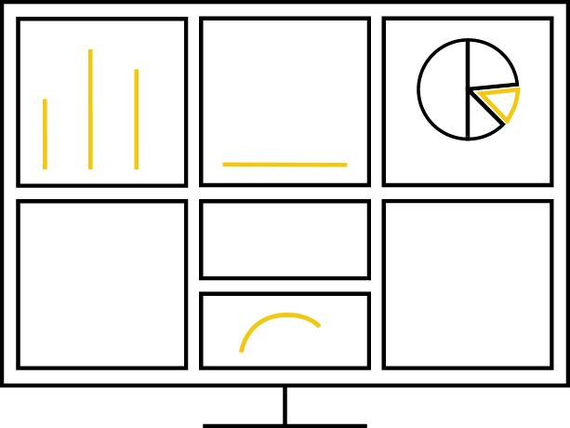


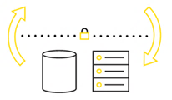
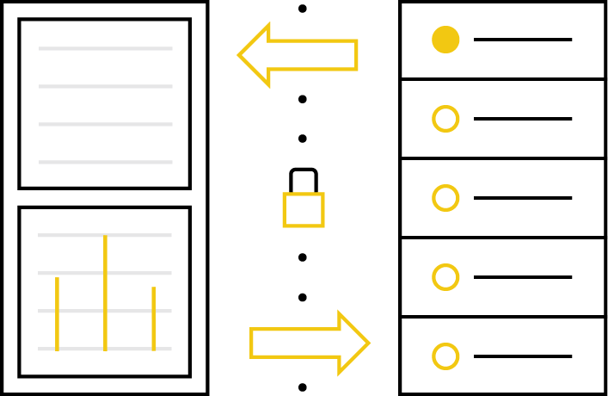
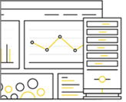
Power BI Ecosystem
Web
Desktop
Mobile
Enterprise BI platform for Executive and Analysts to consume analytics
Exploratory Data Analysis and Self-service BI tool for Power Users to create BI reports.
Mobile App for mobile workforce to consume analytics on the go.
Hybrid
Environments
Developers
and ISVs
Power BI
Report Server
Cloud Scale analytics while connects to data in Azure or on-premise
White-label applications running Power BI Embedded for analytics
Build out pixel perfect or interactive reports deployed on-premise environments.

Slide 5
Modern Analytics Agenda
Power BI Data Flows
Power BI Service
Power BI Report Builder
Power BI Embedded
Power Apps
Notes:
Agenda
Modernization of Analytics Platform to cover these patterns

Slide 6
Reference Architecture

Slide 7
Business Drivers for Modern Analytics
Scale
Real Time Analytics
Cloud (Zero Lock-in or Sunk Costs)
Advanced Analytics
Agile Analytics/TTM

Slide 8
Enterprise BI – System Integrators
https://aka.ms/PBIEnterpriseDeploymentWP
Melissa Coates
Notes:
Modernization patterns for SI is Cloud modernization with Analytics (First Workload & Iterative) == Cloud Ready or Cloud Adoptors
Author == Lower Right
White paper == Lower Left
System Integrator Ref Arch for Enterprise Customers
Power BI Service
Workspace vs App (Dev vs. End-user)
Shared vs. Premium Capacity
End-user tools;Mobile, Desktop, Excel, Service Report Builder
Uptime & HA
Hybrid env as reporting layer in the cloud and data sources on-premise

Slide 9
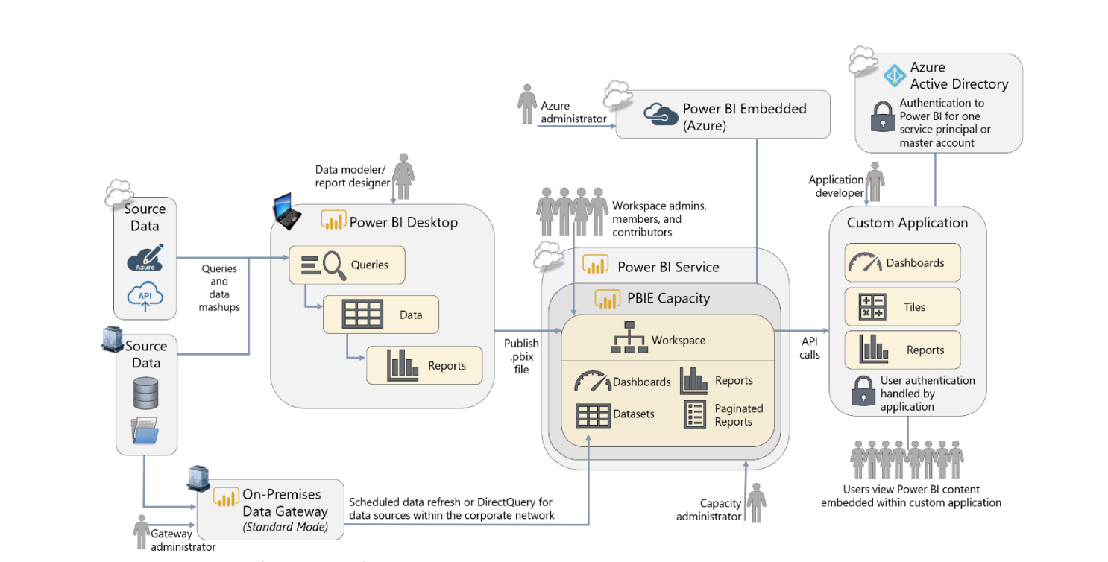
Embedded BI Applications -- ISV
https://aka.ms/PBIEnterpriseDeploymentWP
Melissa Coates
Notes:
Modern Pattern: Embed analytics into App without any framework leveraging familiar end-user tools
Reference Architecture for ISVS to embed analytics into their applications
Power BI Service is distinct tenant from their corporate tenant
One to many applications linked to this tenant
Workspace is tenant for application and customer
Azure PBIE capacity computer engine
End-user consume data thru app
Content creators publish content thru PBI Desktop or Synapse

Slide 10
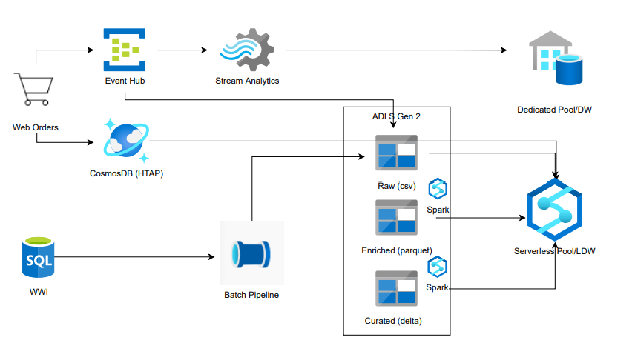
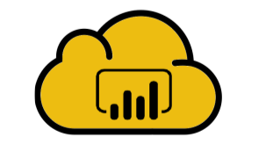
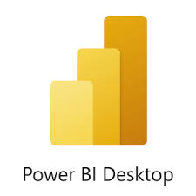






Modern Analytics Architecture
MDW Layer
Analytics Layer
Business Application Layer
Notes:
Drill down on SI Ref Arch
How do we integrate MDW into Analytics platform
New patterns due to Modern Data Warehouse
EDA + BI
Serverless + Dedicated
Data Lake Tiers surfaced thru Synapse
Common tools
Business App Layer
1. Self-service Data flows with Power BI Data Sets
2. EDA on the Data Lake
3. POWER TOOLS (Low-code)
4. Data marts or Departmental BI with PBI Data Sets (Shared)
5. CDM Folders and Dataverse
6. HTAP with Cosmos or Dynamics
7. Ad-hoc Data Augmentation in Workspace folder (Agile BI)

Slide 11
Power BI Data Flows
Data Wrangling
Notes:
Use Case : Business Enablement or Agile BI Self-service Data Flows or Wrangling
Reference Annie’s talk for limitations, decision tree, and how-to

Slide 12


Data collaboration with seamless integration, everywhere
Business analysts
IT professionals
Data scientists
Business analysts
IT professionals, Data scientists
No code, low code
Low to high code
Visualize and report
Model & serve
Train & predict
Advance data prep
Orchestrate & move
Ingest
Power BI
Azure SQL Data Warehouse
Azure Machine Learning
Azure Databricks
Azure Data Factory
Ingest
Dataflows
CDM folders
on Azure Data Lake Storage
Notes:
Replay Historical story between Analyst and DBA/Developer
Outline Benefits for Analyst on low code, metadata catalog and common repository for data
Hand-off to IT to refactor it with Data Factory in the future

Slide 13
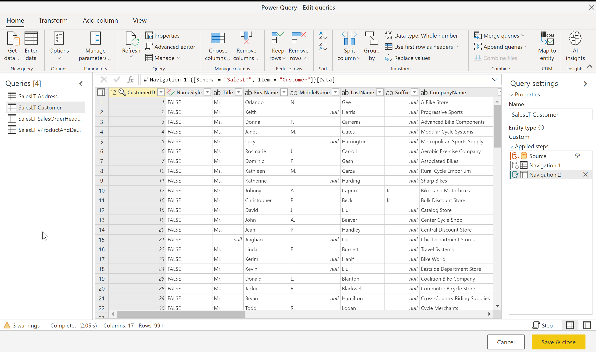
Power Query Online
Transform your data with a familiar Power Query experience
Notes:
Key problem for all of us analyst == Documentation
M Scripting language captures all your steps
Repeatability

Slide 14
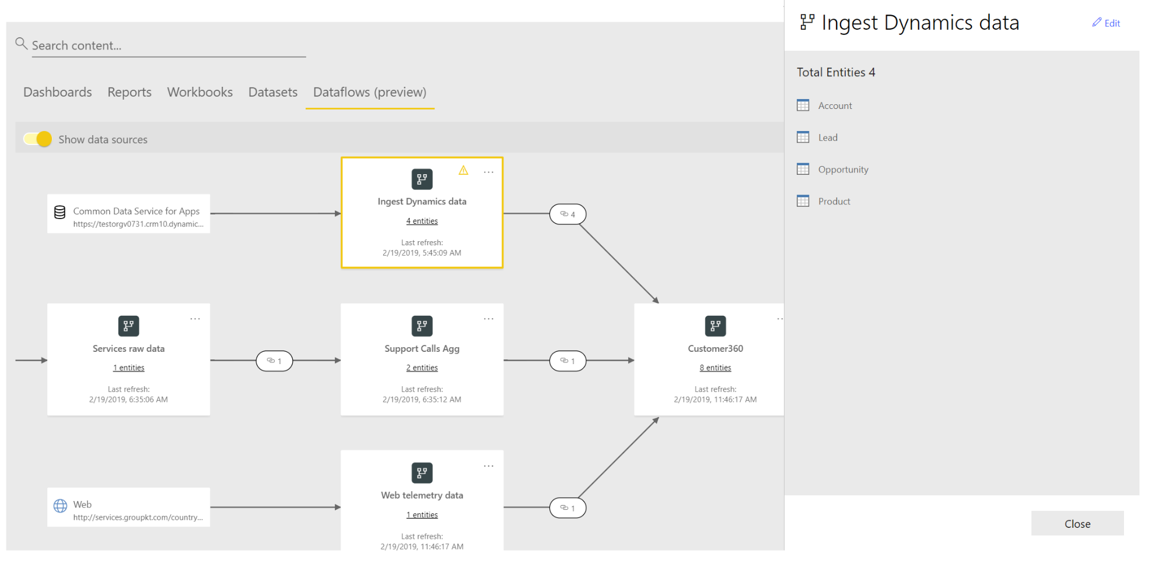
Data Lineage
Data Lineage allows users to understand the flow of data from its source to its destination. Which is a key challenge if you have built advanced analytical projects spanning multiple data sources, artifacts, and dependencies.
Notes:
Analyst dilemma; data across enterprise so there were multiple steps to get to this endpoint
Lineage will show which sources; precedence; types of joins, etc
Hand this over to IT and they can recreate this in their platform of choice
Think of this as a prototyping tool or MVP for agile development No more meetings just Show & Tell
Bananas!!

Slide 15



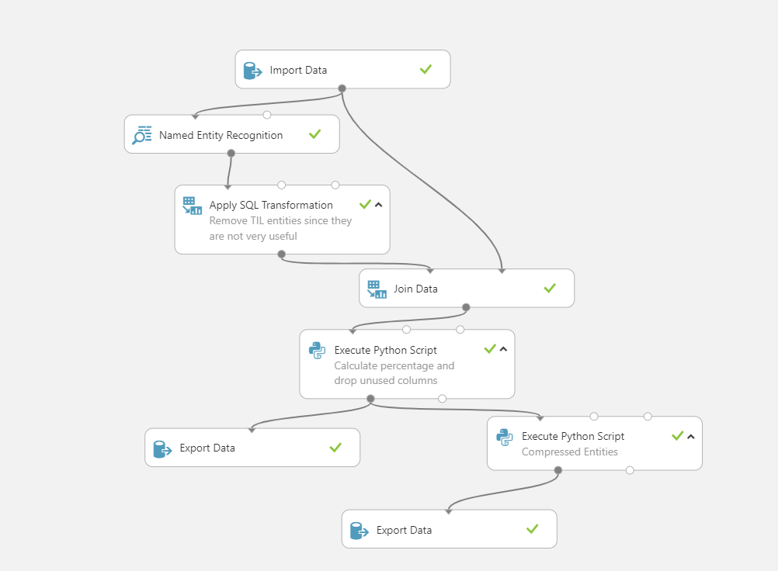
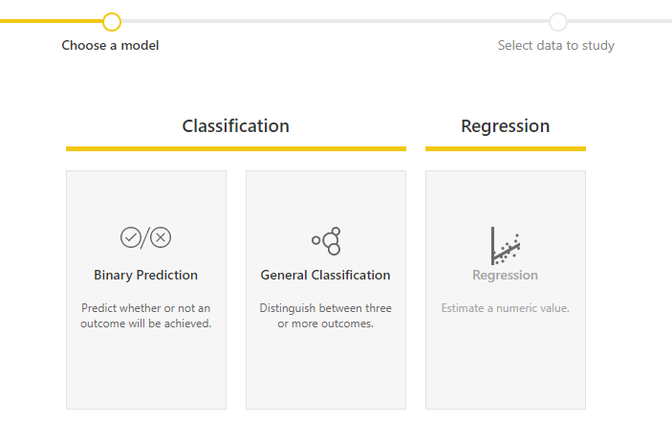
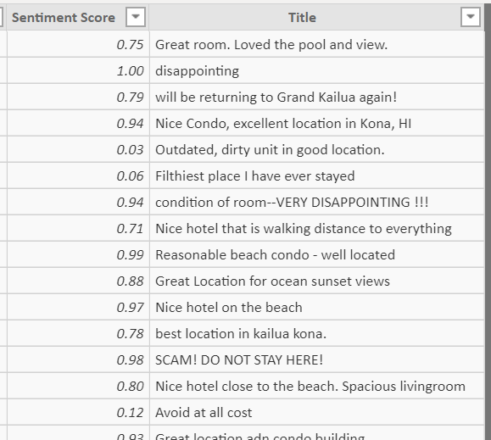
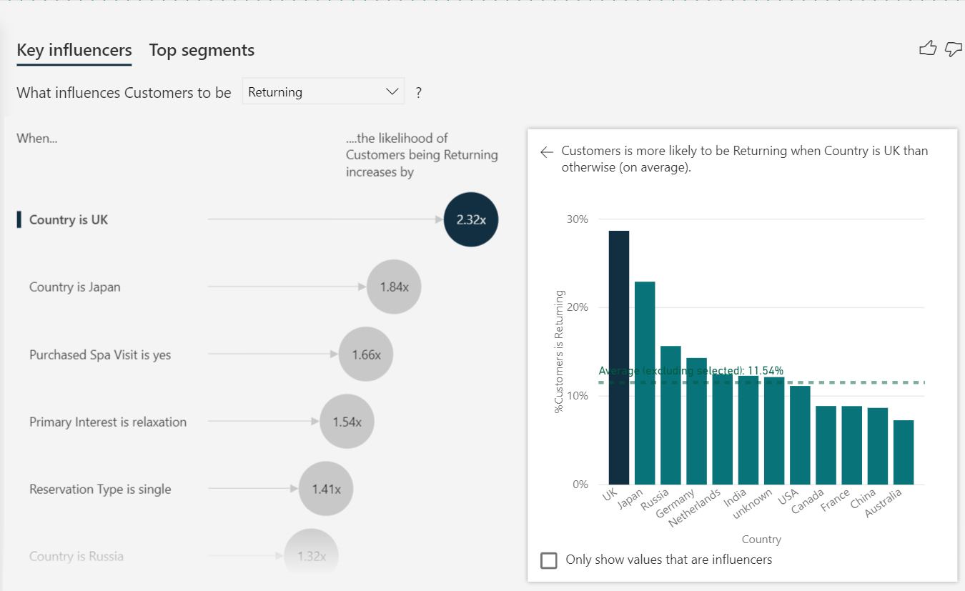
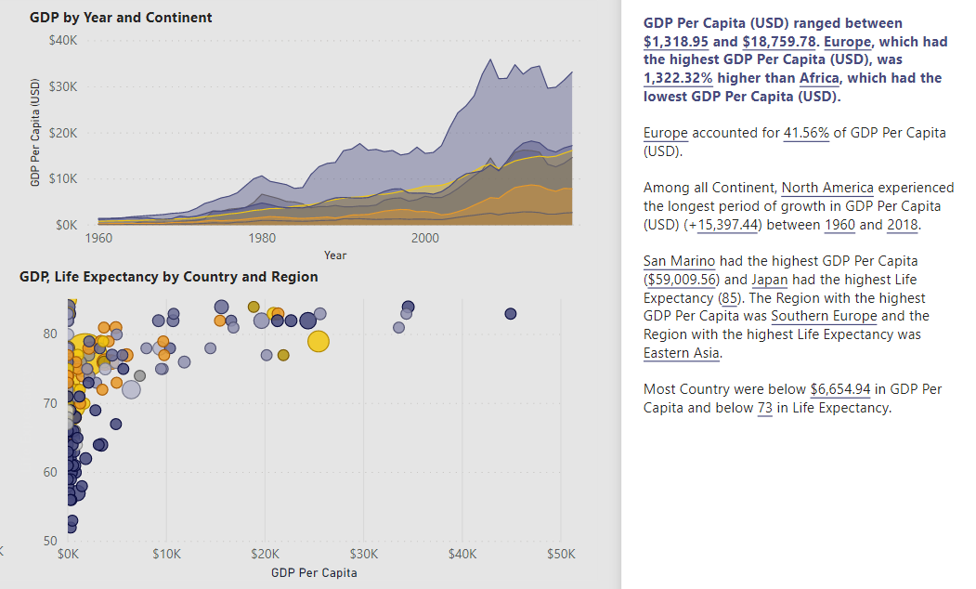
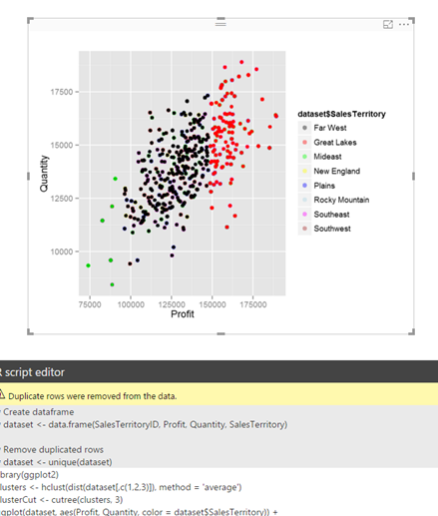
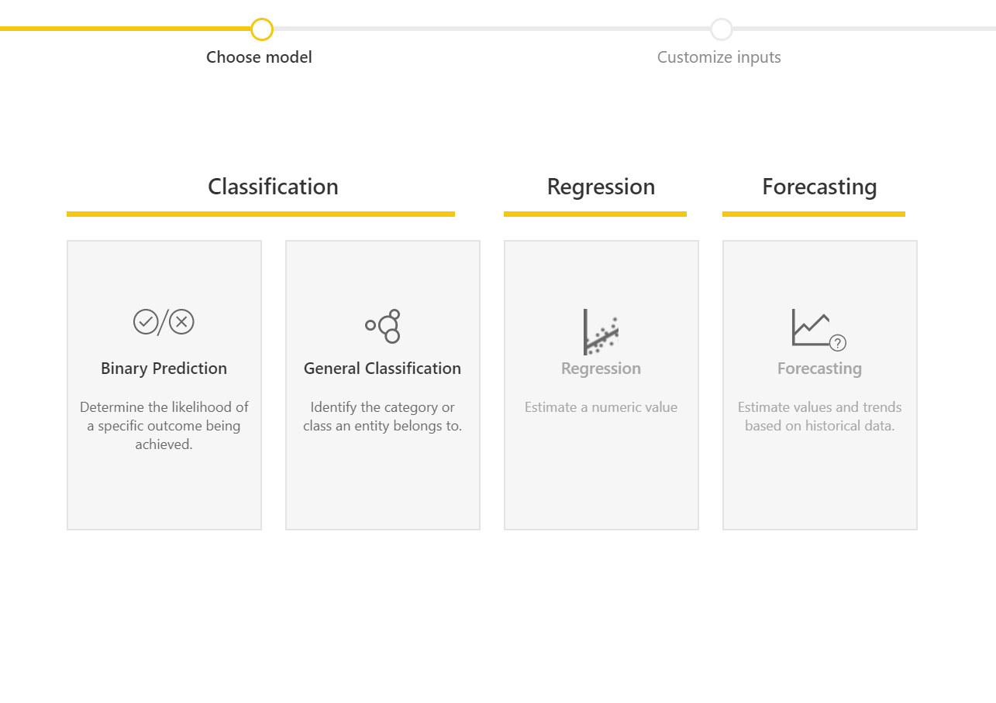
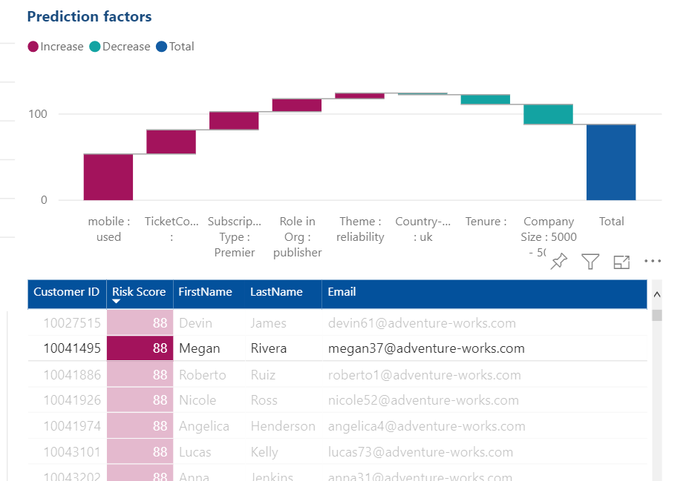
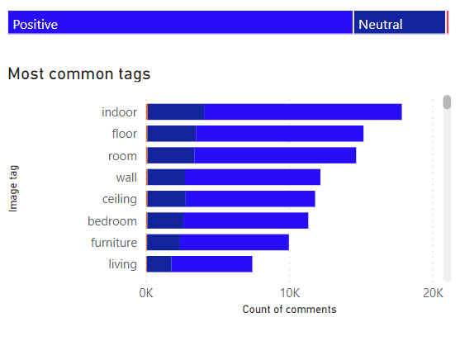
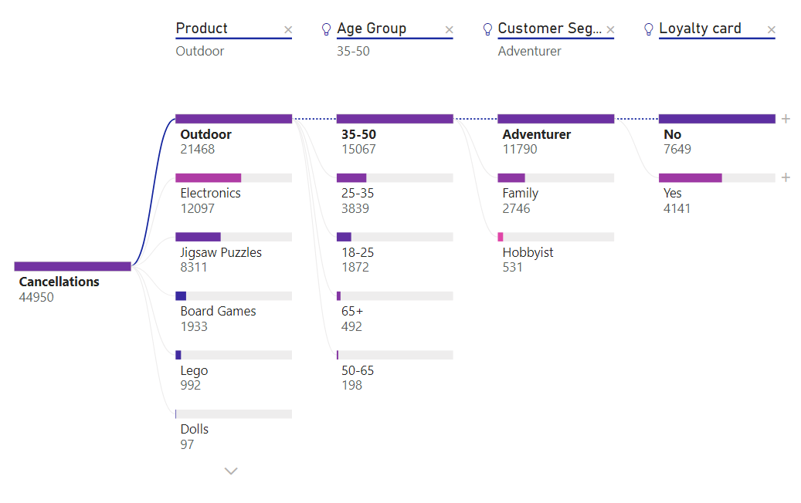
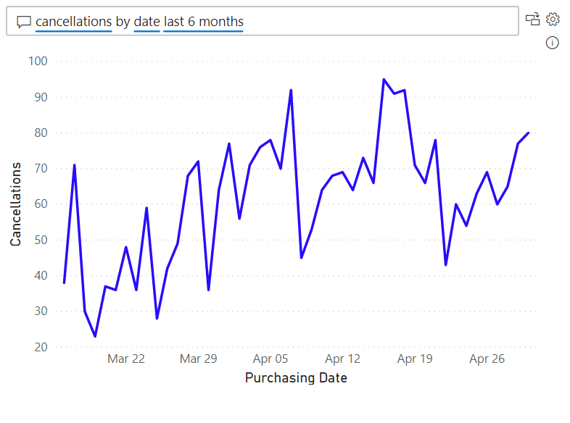
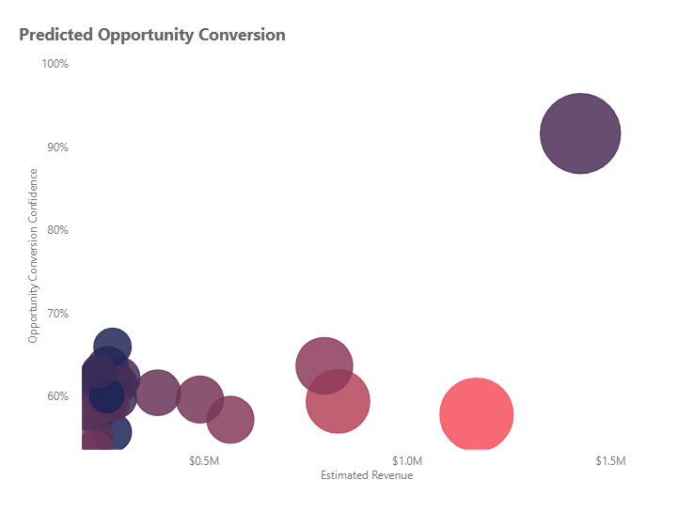
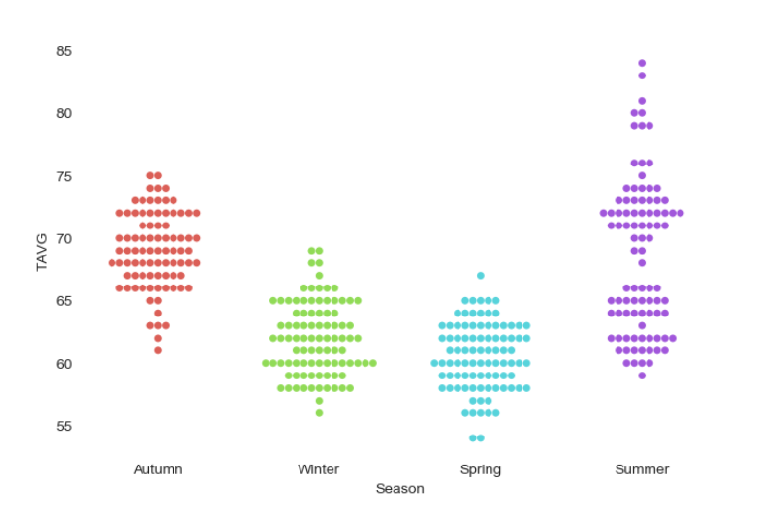
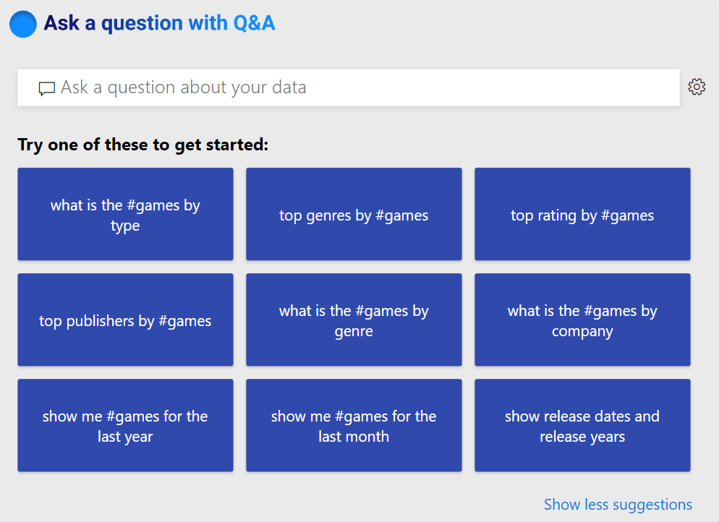

The Most Complete AI Capabilities in a BI Product
Data Scientists
Analysts
End users
Extend with Azure ML
Create ML models
Sentiment Analysis
Key Driver Analysis
Smart Narratives
Python & R Integration
Explore Predictions
Key Phrase Extraction
Root Cause Analysis
Q&A
WhatTheHack/BI2AI
Notes:
Extend Transformations to Predictive Analytcics
Cycle thru use cases

Slide 16
Data Flow Demo
Notes:
Add to current demo AutoML

Slide 17
Power BI Service
Enterprise BI
Notes:
Better together Story of Synapse + PBI

Slide 18





Power BI + Azure Synapse Analytics
Industry leading combination for Enterprise Business Intelligence in the Cloud
Azure Synapse
Power BI
Performance
In-Memory
Security
DirectQuery
Workload Management
Composite Models
Notes:
Power BI Data Sets + Synapse Just Works
DQ or In-memory are supported and doesn’t require AAS
Design with In-memory Cache for Synapse, CSI, Statistics, etc required to support it

Slide 19
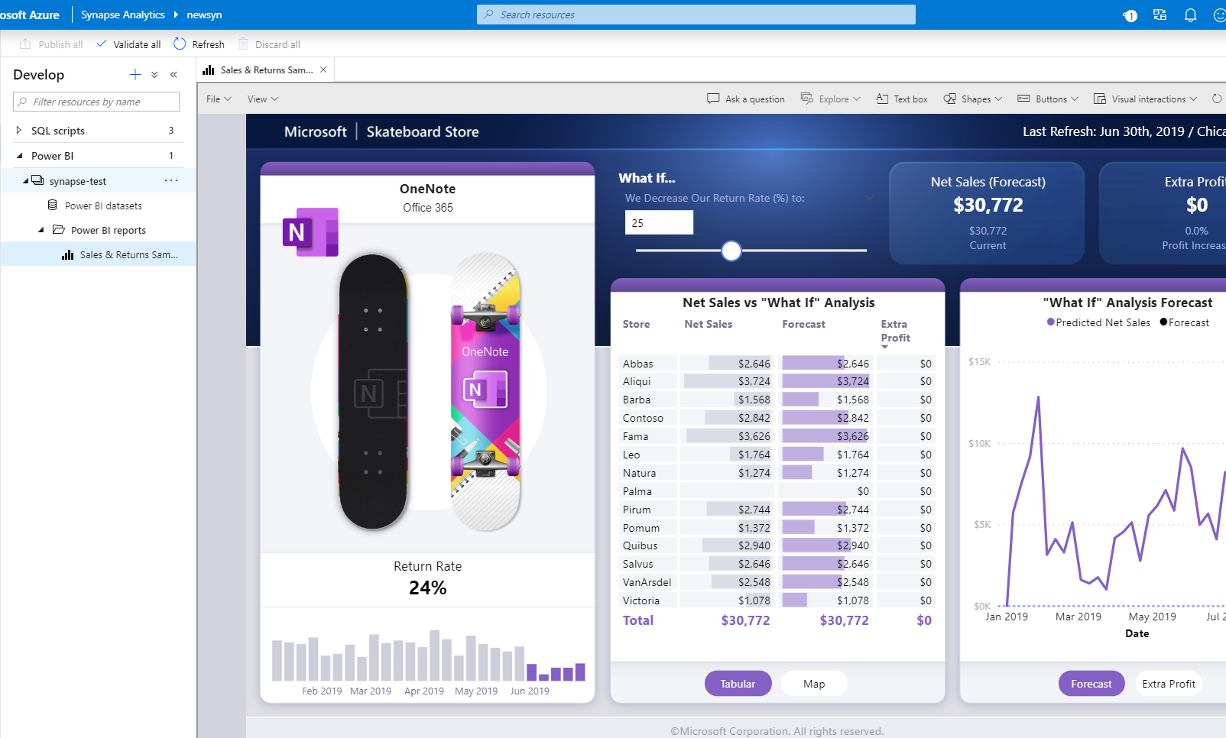
Integrate with Azure Synapse Analytics
Miguel Myers & Chris Hamill
Notes:
Developer Hub for Building out new content
Not a Hub for Consumers
Consumers leverage Power BI

Slide 20
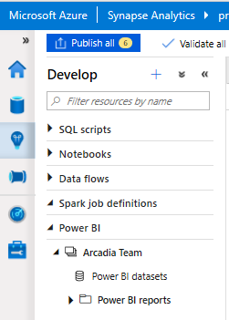
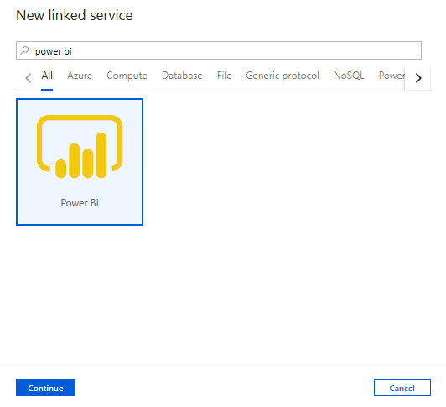
Develop Hub – Power BI
Create Power BI reports in the workspace
Provides access to published reports in the workspace
Update reports real time from Synapse workspace to get it reflected on Power BI service
Visually explore and analyze data
Notes:
Permissions controlled thru Linked Service

Slide 21
Synapse + Power BI
Notes:
Workspace are available in Hub
Apps are not reason for no consumers
Build out Data Sets in Desktop but reports in PBI Developer Hub

Slide 22
Power BI Report Builder
Pixel Perfect Reports
Notes:
Modern Analytics play is not to exclude old technologies that are useful
Canned Reports for pixel perfect reports “GREAT”
Data dumbs thru export to excel “Bananas”

Slide 23
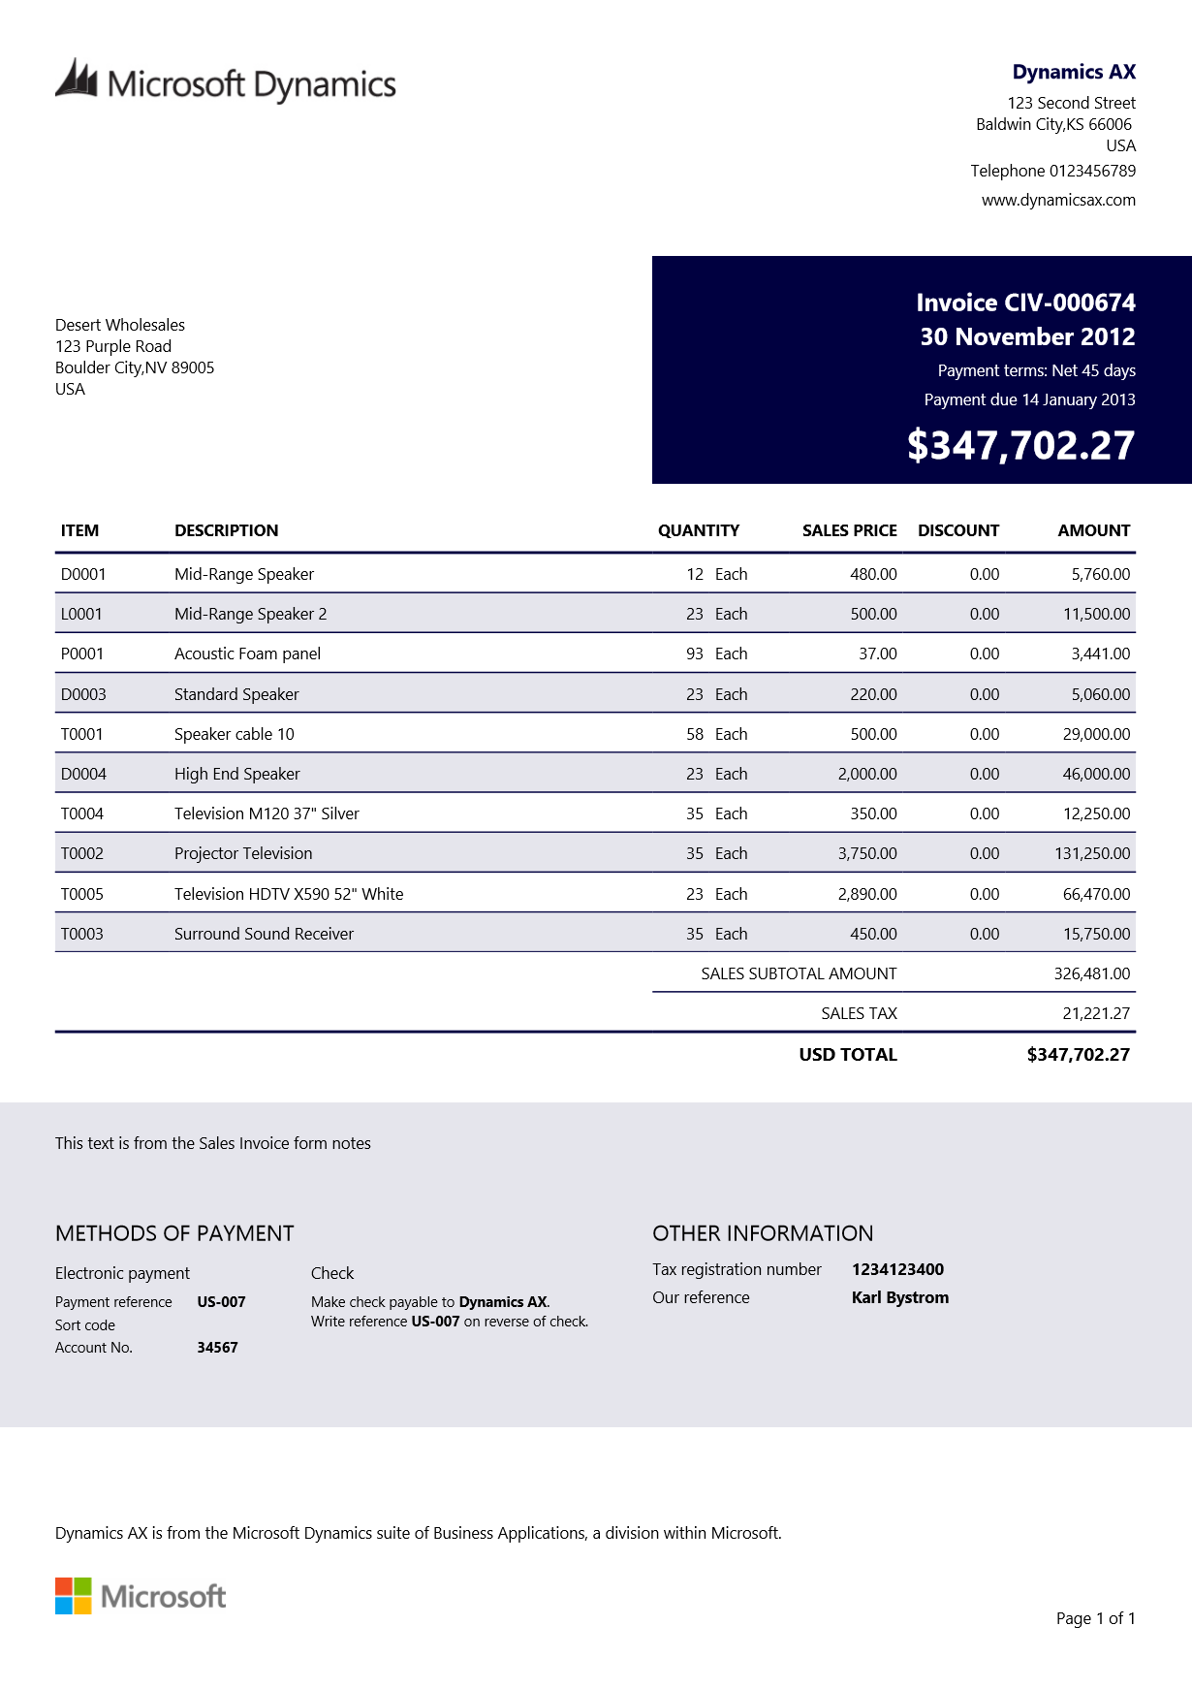
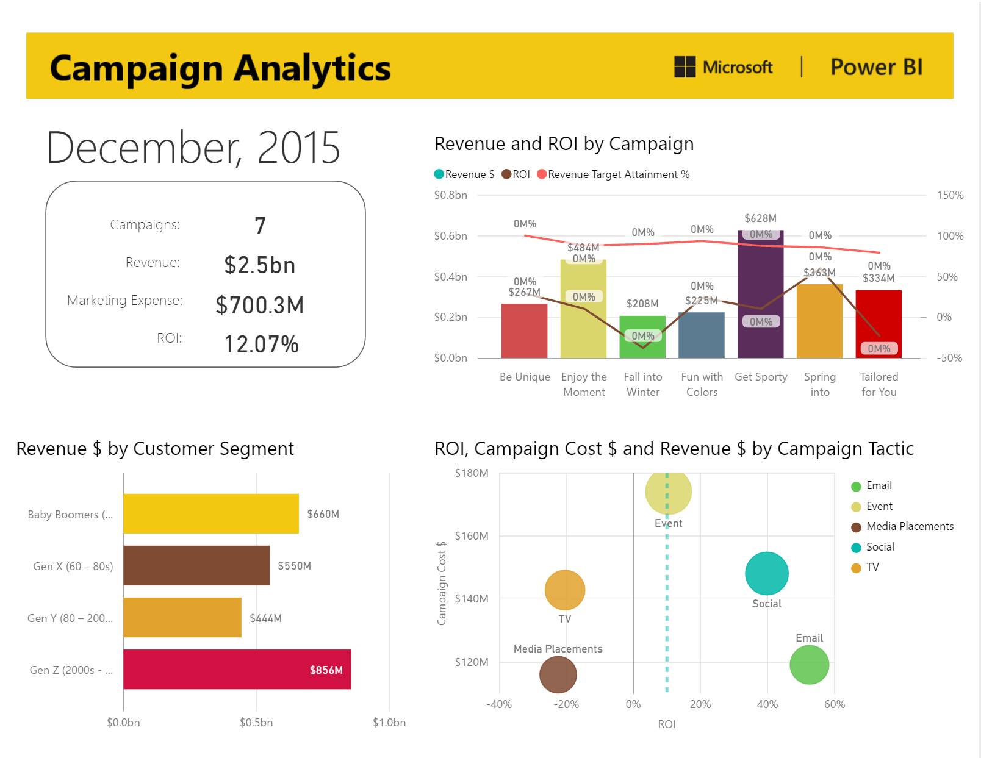
Paginated Reports vs. Power BI reports
Paginated reports (RDL)
Documents generated from data and used in business processes
Analytical reports (PBIX)
On-screen interactive data analysis to discover insights and inform decisions
Notes:
Compare & COntrast

Slide 24
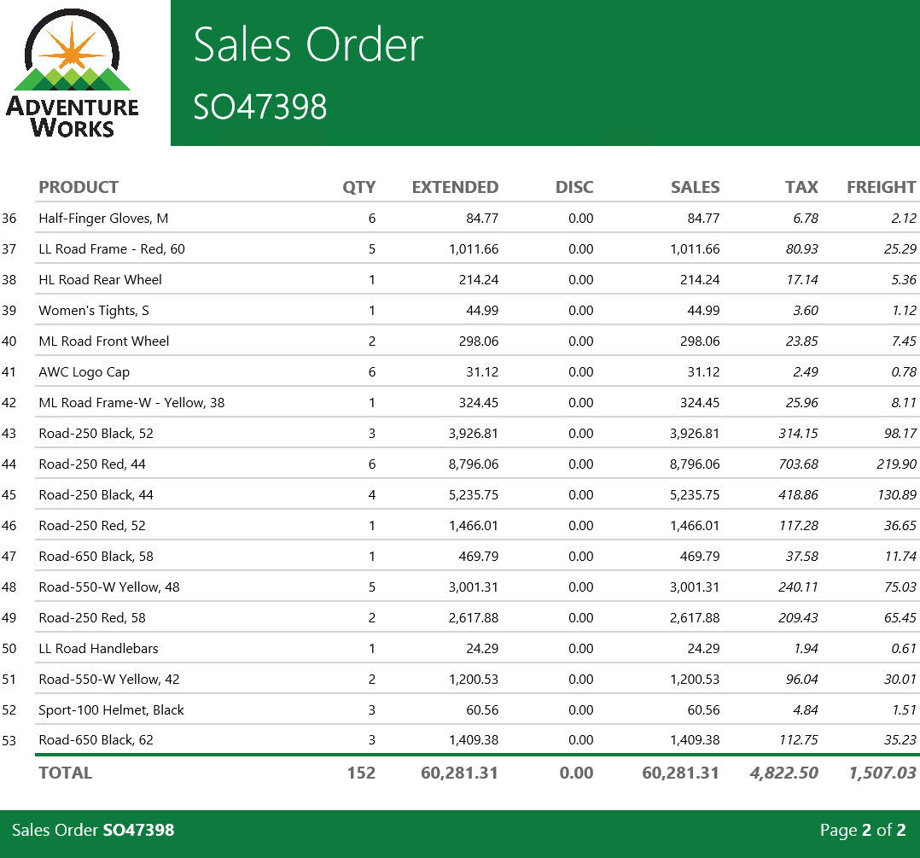
Best practice guidance
Consider using Power BI paginated reports, which can query Azure Synapse Analytics directly
No need to develop a Power BI dataset
Suited to print-ready, pixel-perfect report layouts
Also, they are a good choice when the report needs row-level details
Notes:
Connected to SQL Dedicated Pools (Check Spark)

Slide 25
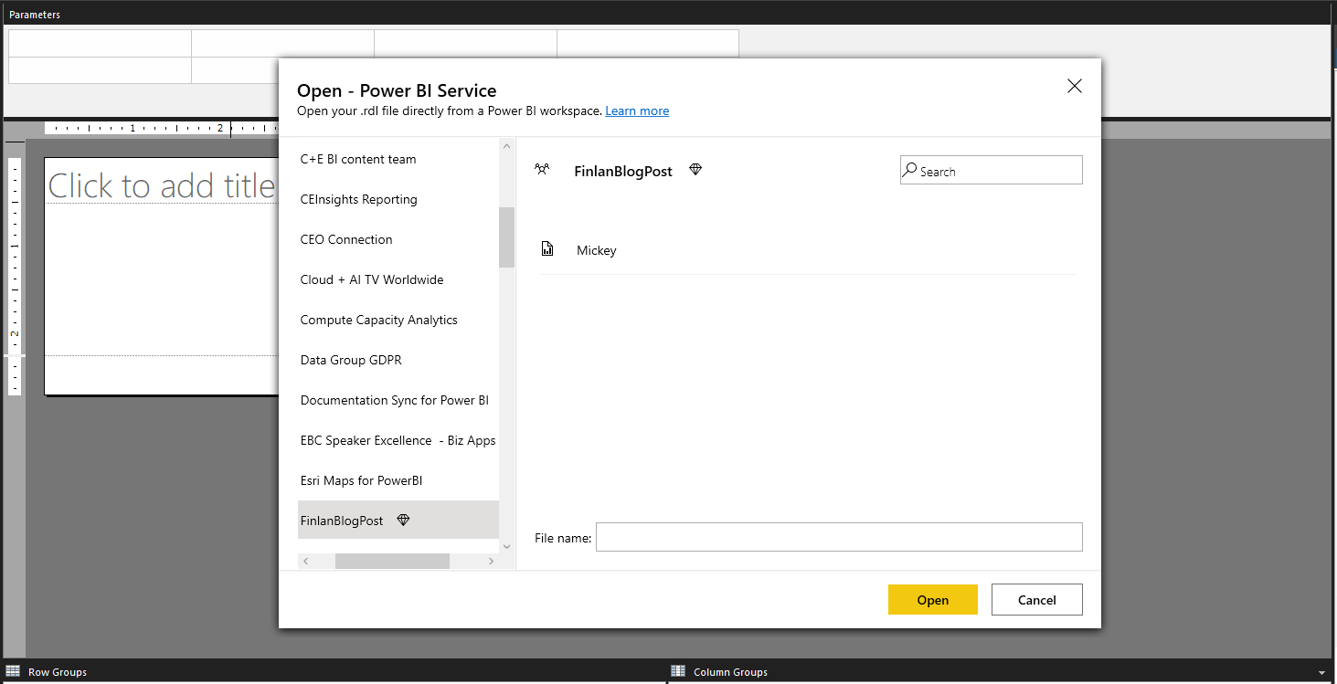
Integrated authoring experience with Power BI
Sign in to Power BI
Search/Browse workspaces
Open/Save directly from/to the Power BI service
Notes:
PBI connect to Power BI Data SEts

Slide 26
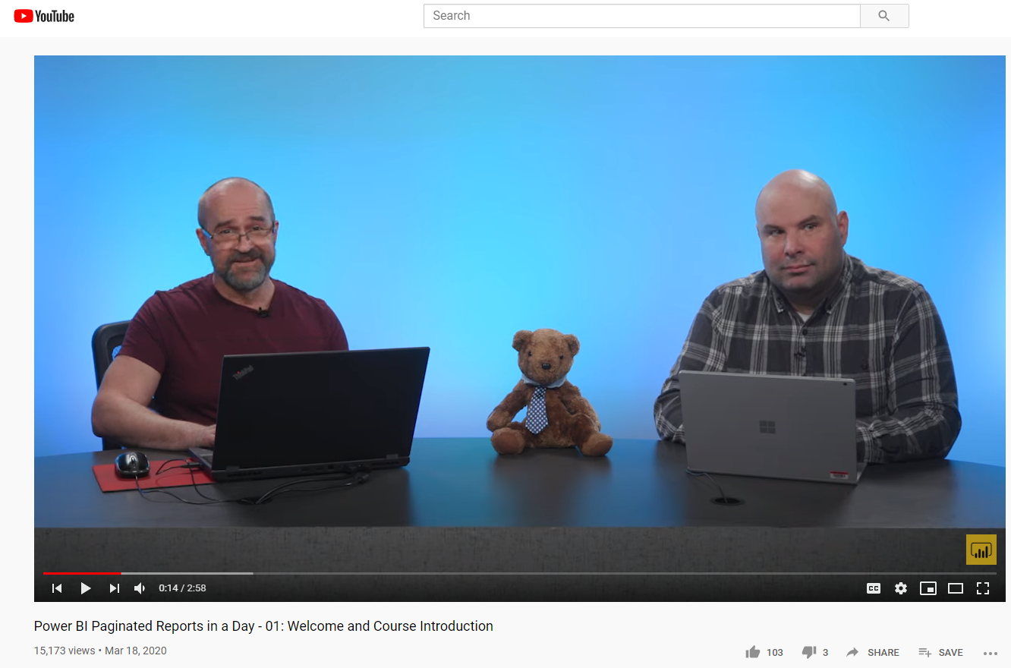
Paginated Reports
Features:
Self-Paced: Paginated Reports in a Day Course
Power BI Paginated Reports in a Day course - Power BI | Microsoft Docs
Peter Myers & Chris Finlan
Notes:
PRIAD Series

Slide 27
Paginated Reports

Slide 28
Power BI Embedded
Solution Builders
Notes:
Modern Analytics for ISV
Cloud Native
REST Endpoint
No need to add frameworks to solution
No need to develop UI for Reports or data modeling
Familiar end-user tool does it for yourself
Pay as you Go

Slide 29

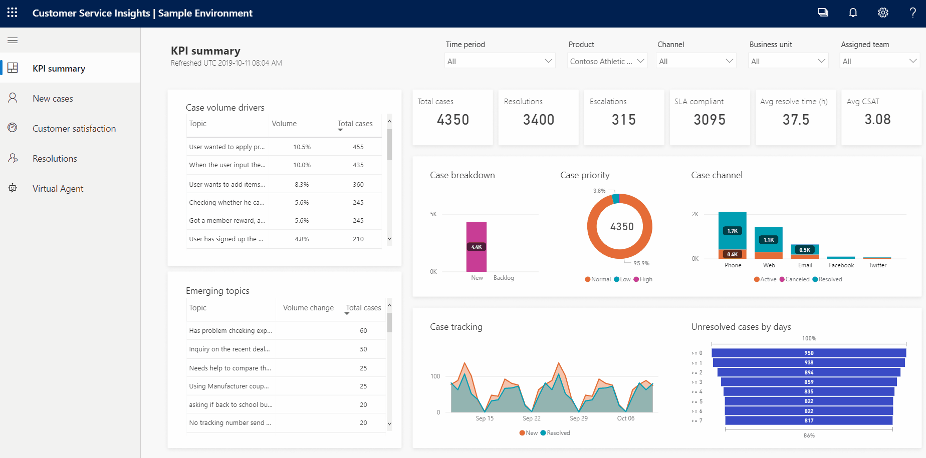

Power BI Embedded in a nutshell
Leverage decades of analytics expertise
No end user licensing required (ISV scenario)
Purpose built for software companies
Total control of visuals and user experience

Slide 30
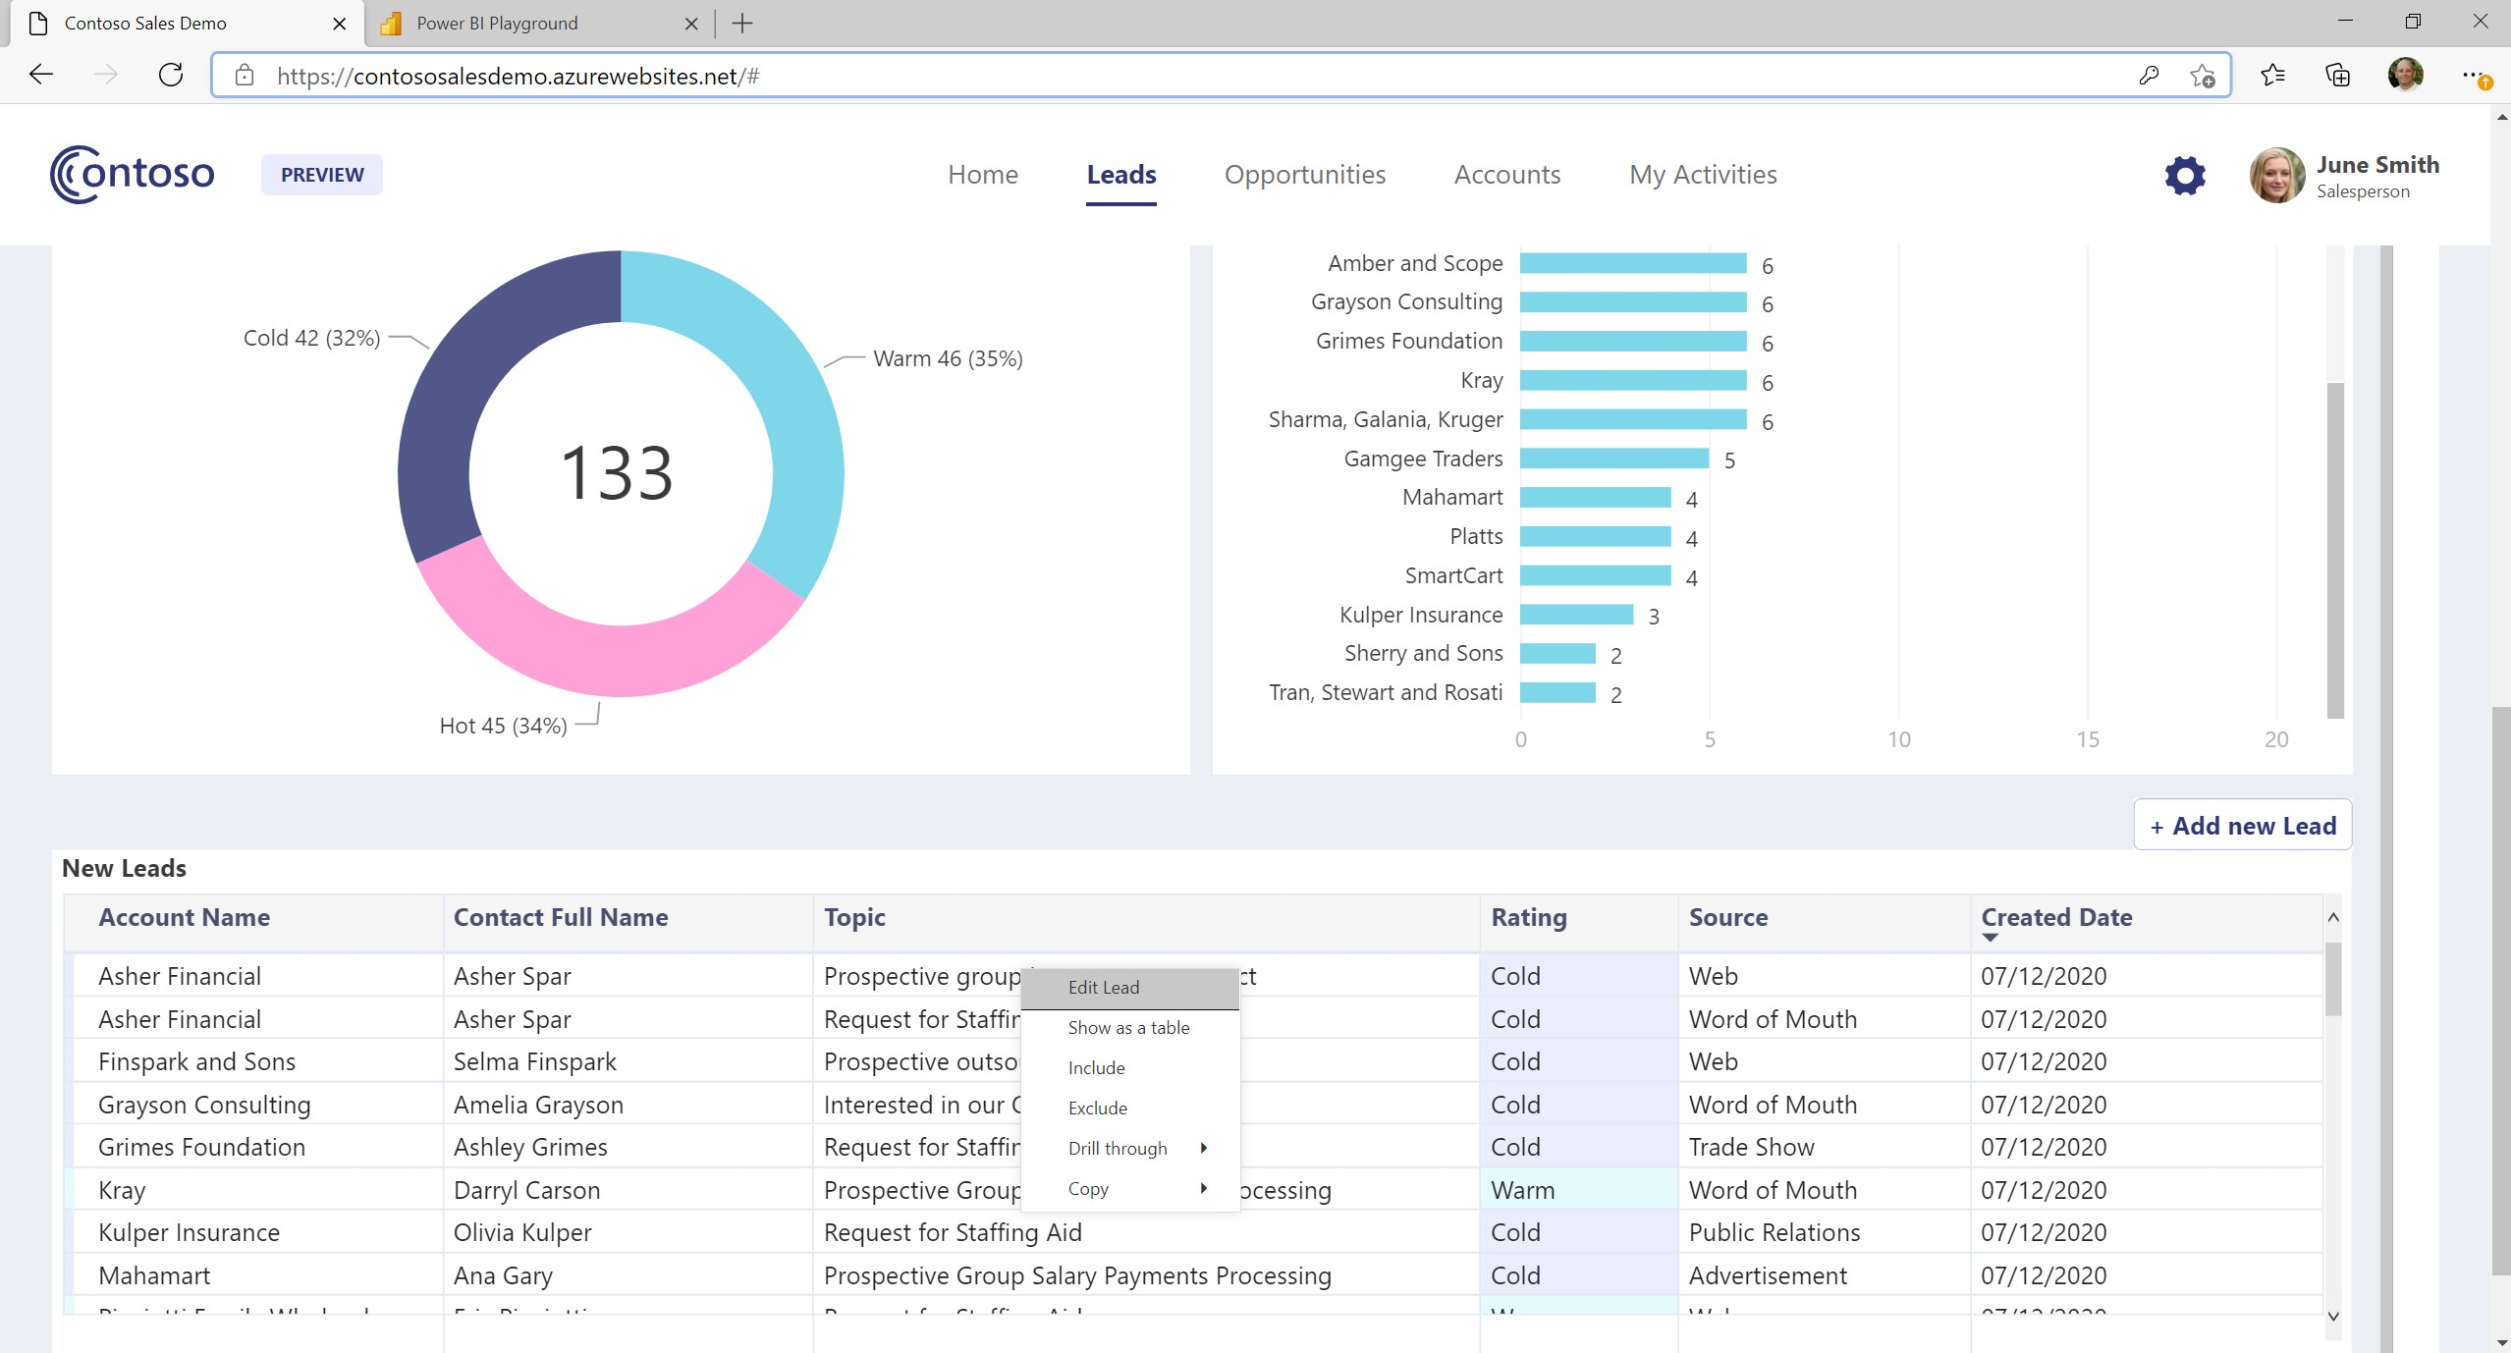
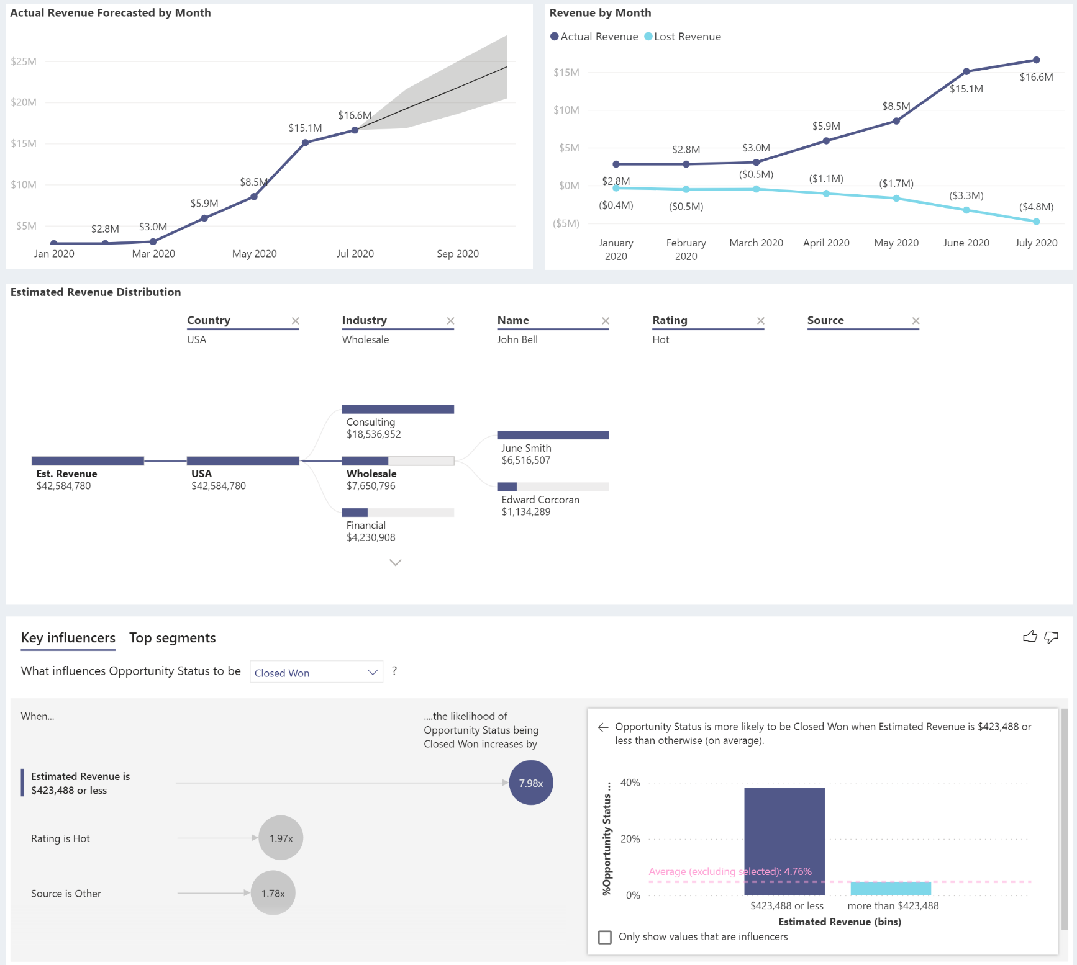
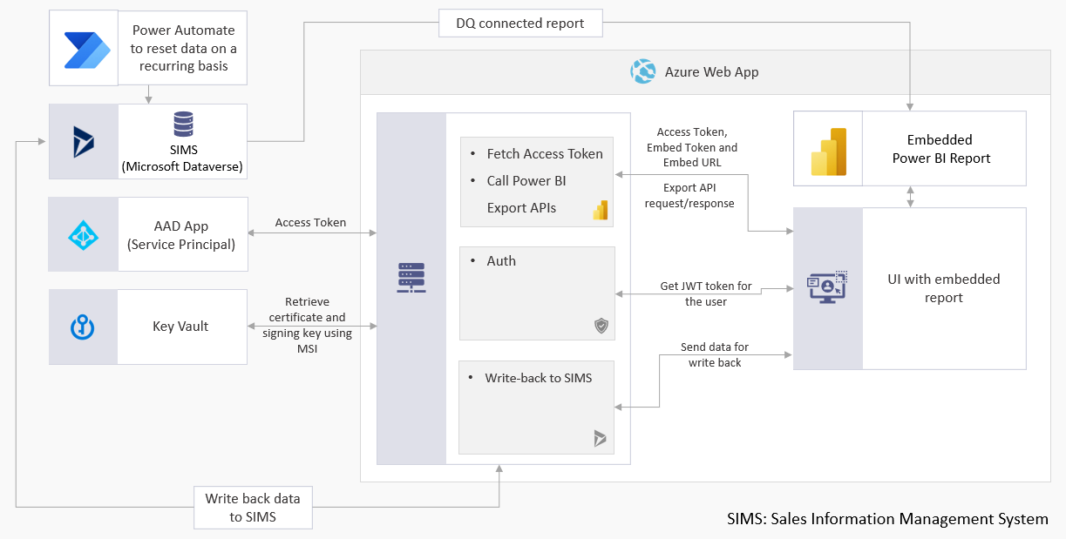
Power BI Embedded Contoso Sales Demo
https://contososalesdemo.azurewebsites.net/ with source code on GitHub

Slide 31
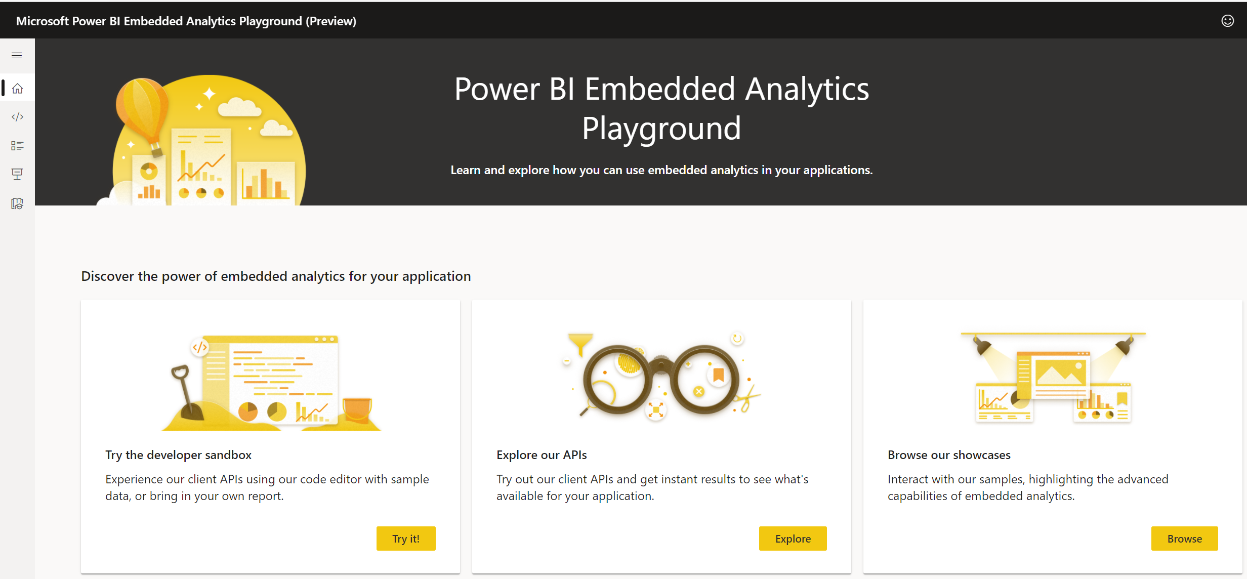
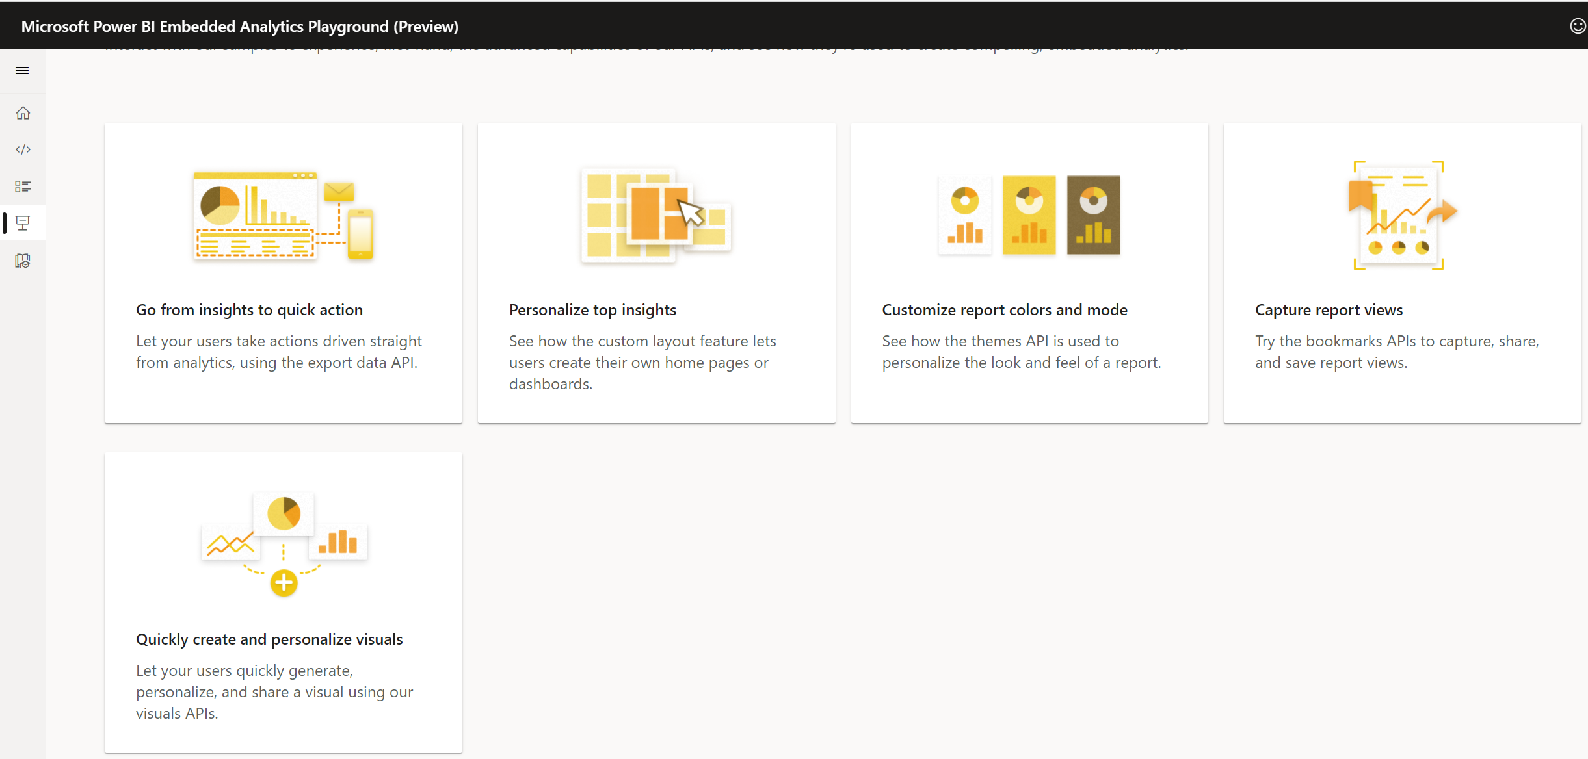
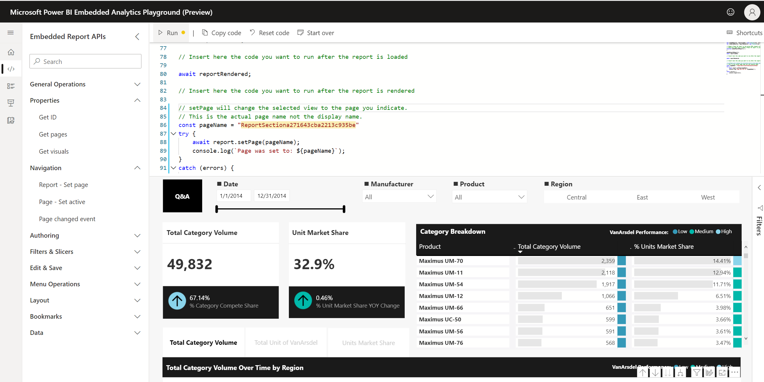
Demos: Power BI Embedded Playground
Control the user experience, report layout and interactions
Match to your brand with color themes
Interact programmatically with visuals
Allow ad-hoc visual creation and editing
Provide answers immediately with Q&A
Use visual data to respond with action in the app
https://aka.ms/pbijs or https://playground.powerbi.com

Slide 32
Power BI Embedded
Contoso Sales Demo

Slide 33
Power BI Products & Licensing Options
Consume and embed with the PBI service
Premium capabilities
Capacity licensing at scale
Author
Author & Share
Scale
Embed for ISV Apps
Desktop
Pro
Premium Per User (PPU)
Premium
Embedded
Licensed per user - for free
Licensed per user per month (free trial)
Licensed per user
per month (details in here)
Licensed by capacity per month (P SKUs)
Licensed by capacity per hour on Azure (A SKUs)
Ad-hoc data exploration and report authoring
Build dashboards
Share and collaborate
Package and publish apps
Same as Pro with access to Premium capabilities
Large scale deployments
without requiring per user licensing
Embed for your application used by external app users
Report Builder
Premium EM SKUs
Lower capacity with yearly commitment
Author paginated reports
See further details here
SKUs that can work with PBI end-user authentication
Cannot work with PBI end-user auth in production
See Pricing details here
See Pricing details here
33

Slide 34
Agile BI with Power Apps
Low Code /No-Code with POWER Tools

Slide 35




Power Platform
The low-code platform that spans Office 365, Azure, Dynamics 365, and standalone applications
Innovation anywhere. Unlocks value everywhere.
Power BI
Business analytics
Power Apps
Application development
Power Automate
Workflow automation
Power Virtual Agents
Intelligent virtual agents
Data connectors
AI Builder
Microsoft Dataverse

Slide 36

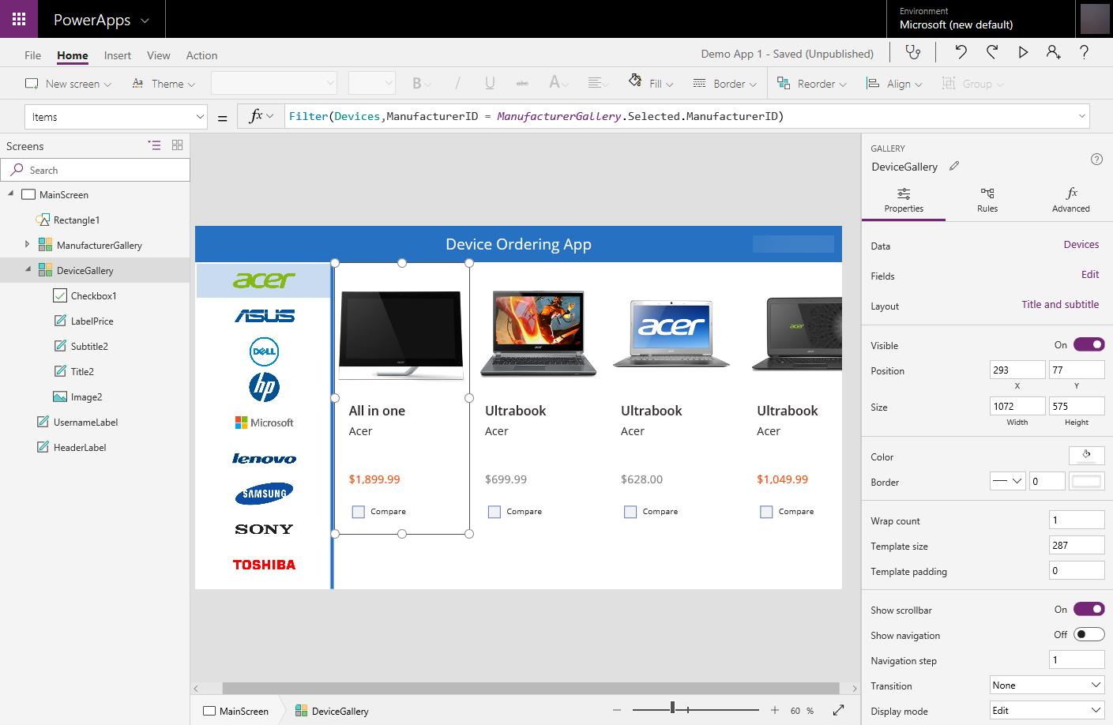


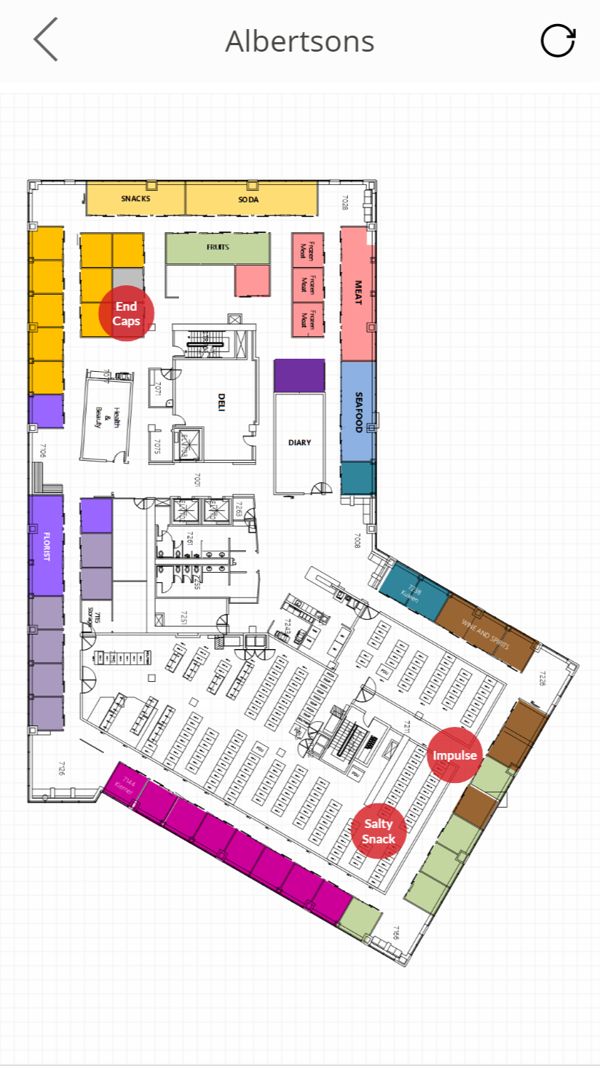
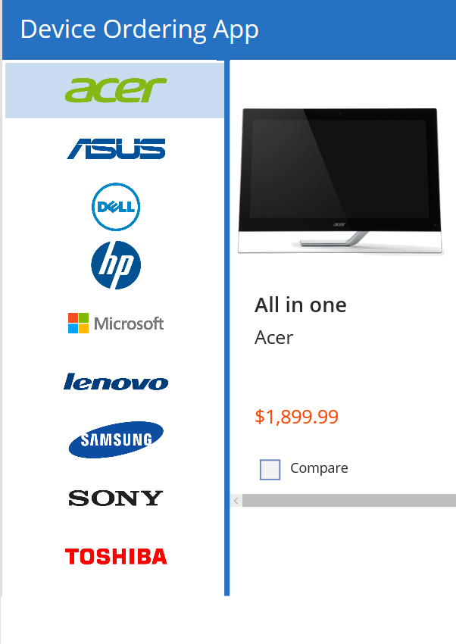
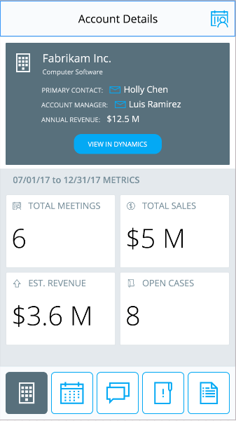

Power Apps: a low-code approach to building apps
Easily build apps with a full featured low-code / no-code platform
Connect to your existing data with 250+ pre-built connectors and custom connectors
Store your data in Dataverse
Integrated with Office 365, Azure, Dynamics 365, and Power BI
Strong enterprise governance & security
Pro-dev extensibility

Slide 37

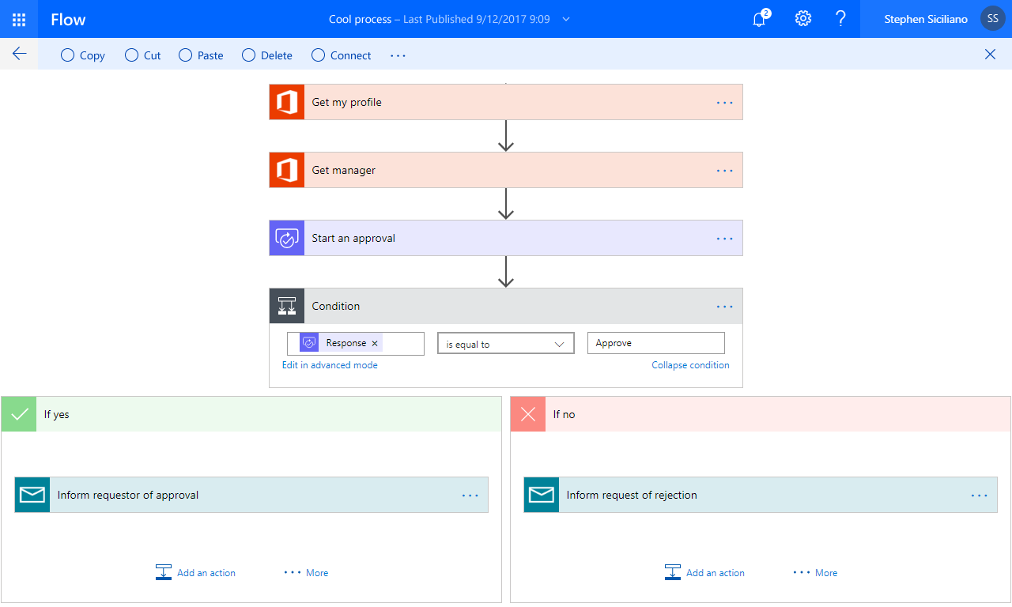
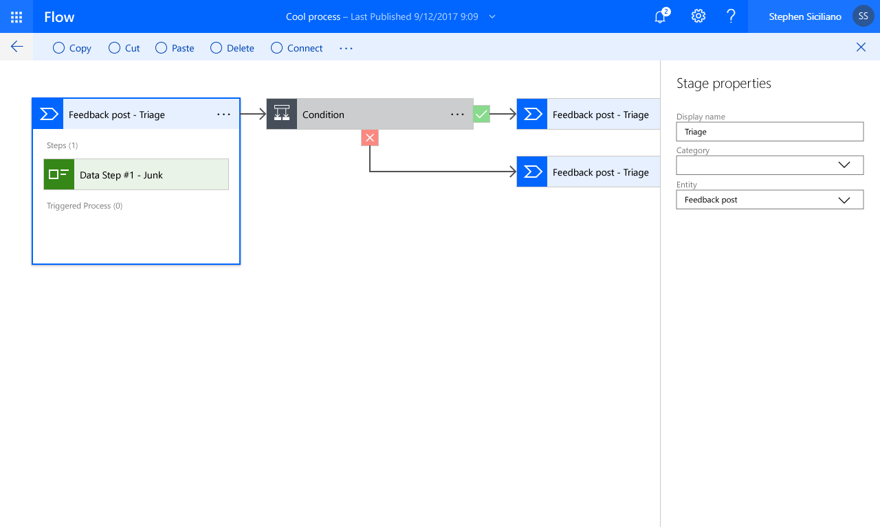

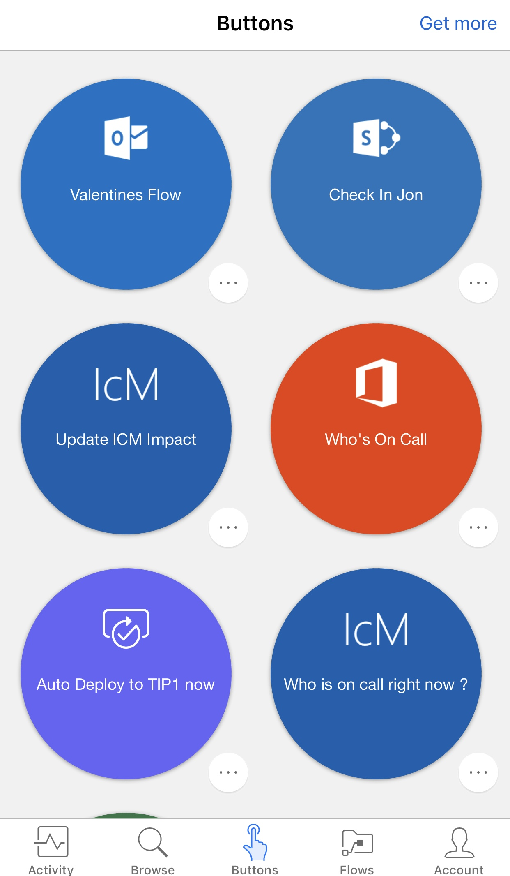
Automate business processes with Power Automate
Automate and model business processes across your apps and services
From simple automations to advanced scenarios with branches, loops, and more
Trigger actions, grant approvals, and get notifications right where you work
Enterprise-grade
Cloud and on-premises connectivity
Pro-developer extensibility

Slide 38
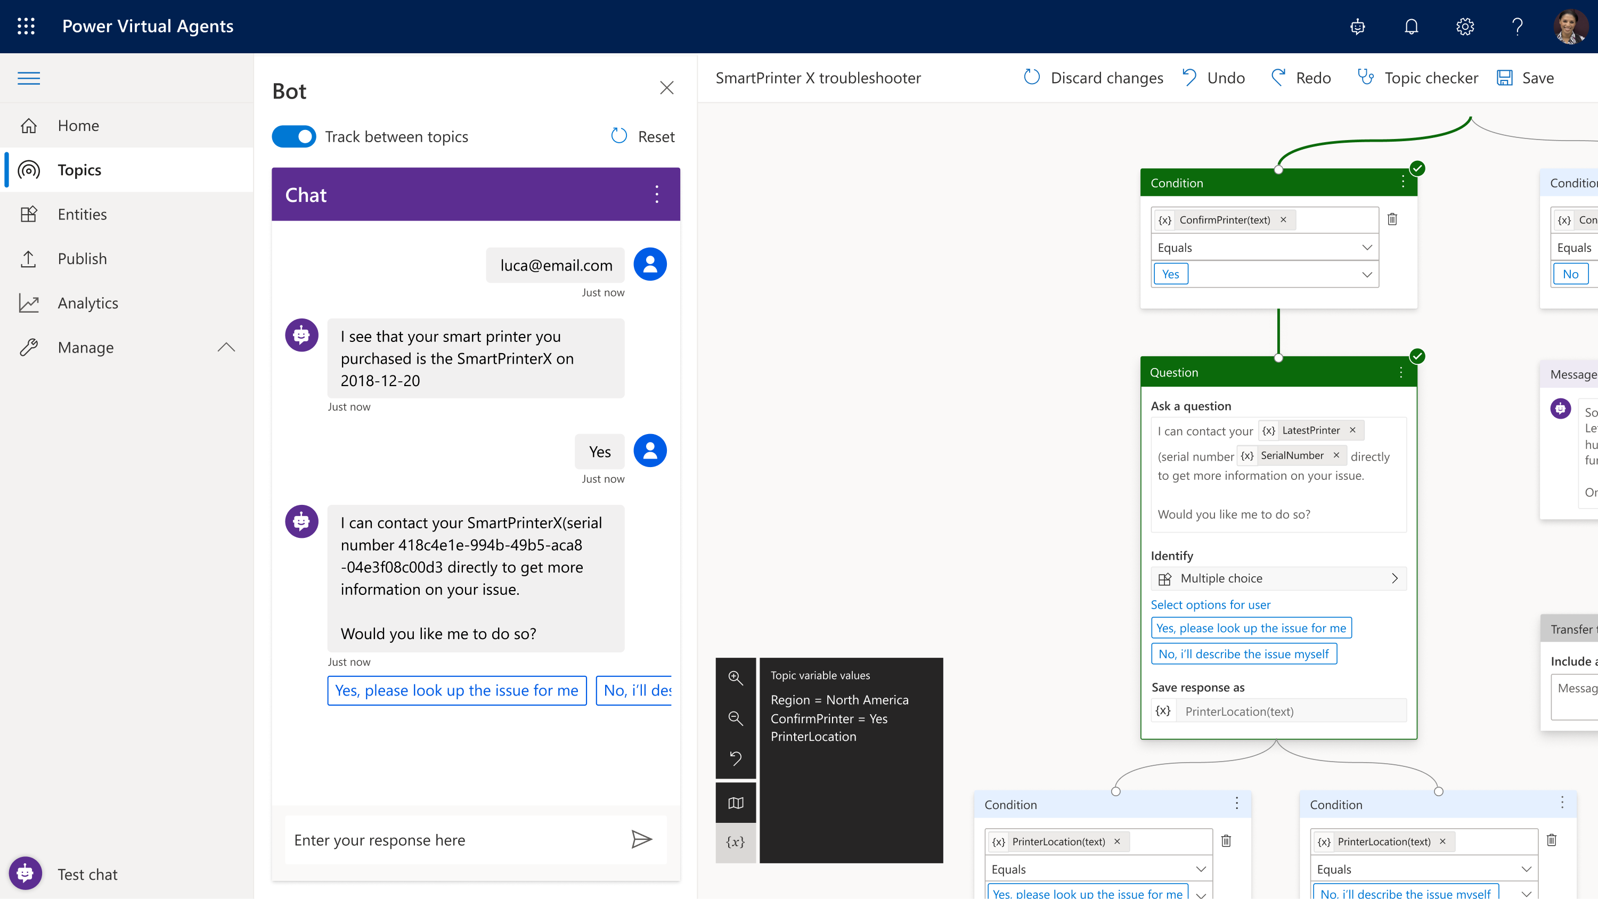
Build powerful agents with Power Virtual Agents
Enable subject matter experts to easily create powerful virtual agents using a guided, no-code graphical interface—all without the need for data scientists or developers.
Enable the virtual agent to take action on the customer’s behalf. Easily integrate your virtual agent with hundreds of services and systems out of the box or create custom workflows.
Keep an eye on how your virtual agent is performing by using conversational metrics and dashboards. Get in-depth AI-driven insights to improve bot performance.

Slide 39
Thank you

Slide 40
Slide header
Column header
Column header
Column header
Column header
Bullet points or text
Bullet points or text
Bullet points or text
Bullet points or text

Slide 41
Slide header
Descriptive text in sentence form with some details, highlighted text or callouts.
Descriptive text in sentence form with some details, highlighted text or callouts.
Descriptive text in sentence form with some details, highlighted text or callouts.
Descriptive text in sentence form with some details, highlighted text or callouts.
Descriptive text in sentence form with some details, highlighted text or callouts.
Descriptive text in sentence form with some details, highlighted text or callouts.
Descriptive text in sentence form with some details, highlighted text or callouts.
Descriptive text in sentence form with some details, highlighted text or callouts.

Slide 42
Resources
Power BI Desktop
Governance
Resource name
Resource name
Resource name
Resource name
Resource name
Resource name
Power BI Service
Best Practices
Resource name
Resource name
Resource name
Resource name
Resource name
Resource name
Power BI Lifecycle
Administration
Resource name
Resource name
Resource name
Resource name
Resource name
Resource name

Slide 43
“Insert quote text here. This layout accommodates longer quotes very well.”
Name attribute
Job title or another attribute

Slide 44
Resources
Resource type
Resource type
Resource name
Resource name
Resource name
Resource name
Resource name
Resource name
Resource type
Resource type
Resource name
Resource name
Resource name
Resource name
Resource name
Resource name
Resource type
Resource type
Resource name
Resource name
Resource name
Resource name
Resource name
Resource name

